Slide 1
IT1762
Data Structures & Algorithms
Topic 4
Class and Objects in C#

Slide 2
Objectives:
Understand classes & objects.
How to define a class
  data member
  method member
How to create objects from a class.

Slide 3
Classes and Objects
Classes are used to group data that belongs to the same object.
Example of an object student – Jackie
One advantage of Class – can store different types of data ( eg. compare to array )
We can define a class like this:
class class-name
{
private variables & methods of the class
public variables & methods of the class
}
A class is a Blueprint or Template to create OBJECTS.
Example:
Handphone class → HP design plan that allow us to produce real handphones such as Nokia, Samsung etc…
House class → building plan that help us to build actual buildings such as a terrace house.

Slide 4
Class Is User-Defined Type:
In the class definition, the class-name is a new type name defined by the programmer and is used to declare objects of the class.
The programmer can create his/her own class to solve a particular problem.
Example 1:
Problem – design a computer program that handles handphone data.
Solution – create a Handphone class.
Example 2:
Problem – design a computer program that handles student registration.
Solution – create a Student class.

Slide 5
Class Vs Objects
A Class is a NOT REAL. It is a paper design like a Blueprint or Template.
Class
Object A
Object B
Object C
Class Car
Object
Honda
Object
Suzuki
Object
Toyota
Objects are REAL. They are created from the Class definition. You create ONE class definition and instantiate MANY objects

Slide 6
What’s Inside a Class ?
Among other things, a class contains data and methods.
Class Members (Data & methods):
Methods (what it can do?) and variables (what it has?) declared inside a class declaration are said to be members of that class.
Members are Private by Default:
By default, all methods and variables declared inside a class are private to that class. This means that they are accessible only by other members of that class.
Public Members:
To declare public class members, the public keyword is used. Public members can be used by everybody.

Slide 7
class – Person
Member: data (it has.. ) e.g gender=‘F’, hairColor= Golden
Member: method (it can ..) e.g update(), display(), setMotion(), changeHairstyle()
Example of CLASS :
Mary
Sally
class : Person
From ONE class, you can create many objects of different member data.
As a result, create many person objects.
Ben
Tom

Slide 8
Person Class and Objects
Class Person
Object
Mary
Object
Sally
Object
Ben
Object
Tom
Class Person is a template.
From there, we create 4 Objects.
They are Mary, Sally, Ben and Tom.

Slide 9
A class definition in C#:
class Person // class name
{
//declare data members
int age; // default, it is private
private string name;
public float height;
//declare methods
public void display( )
{ .................... }
}
The keyword public allows the outside world to have direct access to any public members (either data or methods).
If no access modifier is stated, the default is private.
Here age and name are private, and height and display( ) are public.

Slide 10
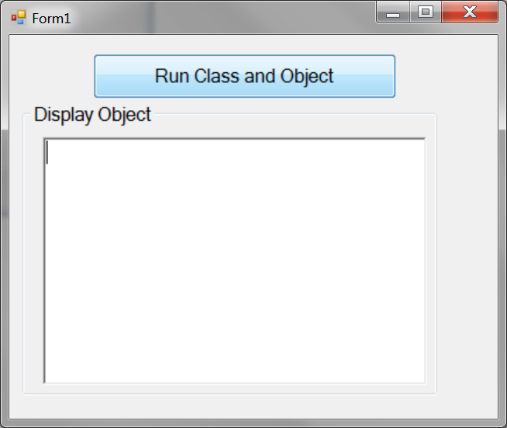
C# example1 on class and object
Here is an example in C# to show how
  To define a Class
  To apply One Class
  To create One Object with default values
  To update Object data
Create the form and GUI as follows
When user clicks on the button, it creates a object of Person class and display the data
btnRun
rtbDisplay

Slide 11
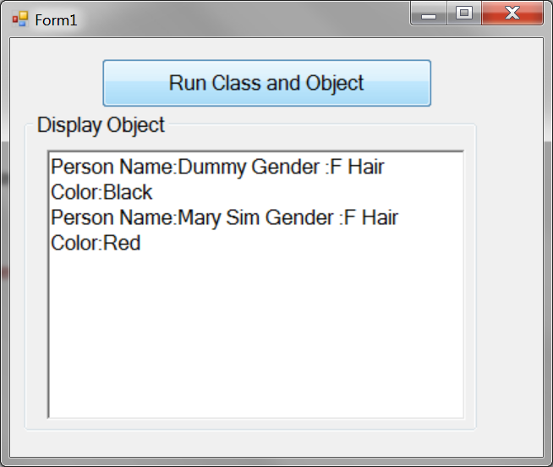
C# example1 on class and object
The output of the application:
Display default value
Display updated value

Slide 12
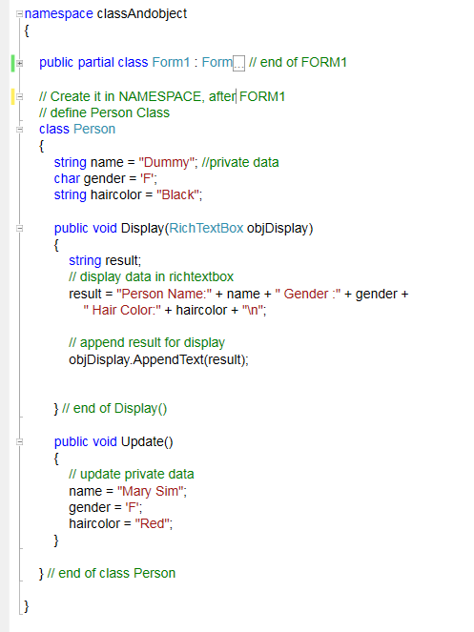
C# code example1:
Create a Person Class
Every Person has name, gender and haircolor (variables)
Every Person can Display() (method). It displays the data to RichText Box
Every Person can Update() (method). It sets the name to “Mary Sim” etc

Slide 13
Explain the class definition:
Person class
Member data (default values):
name=“Dummy”, gender=‘F’,
hairColor= “Black”
Member method :
Update (), Display ()
Member data are private but Member method are public
Why? Data is only accessible within class but Method is accessible outside class
IMPT***: There is NO name, gender and haircolor variables declared in DISPLAY() and Update()
Why? Because we use the data in the member data
Person

Slide 14
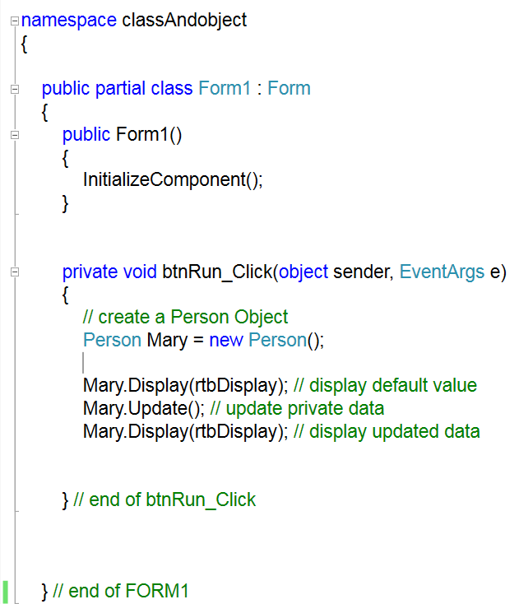
C# code example continue
Create a OBJECT from Person CLASS
Create a Object of a Person, named as Mary
Call Mary’s member method to display and update

Slide 15
How to create Object?
Person Mary = new Person( );
new is the Keyword to create an object.
Mary is the object name
Person is the class name
Person() is the constructor method to create an object
Mary.Update(), Mary.Display()
The symbol ‘.’ is working like ‘s in English language.
E.g Object1.Update() implies Object1’s update() method
Mary.Update() implies that you are calling the Update() of Mary object
Mary.Display() implies that you are calling the Display() of Mary object
However, We cannot access to Mary.name because it is a PRIVATE data

Slide 16
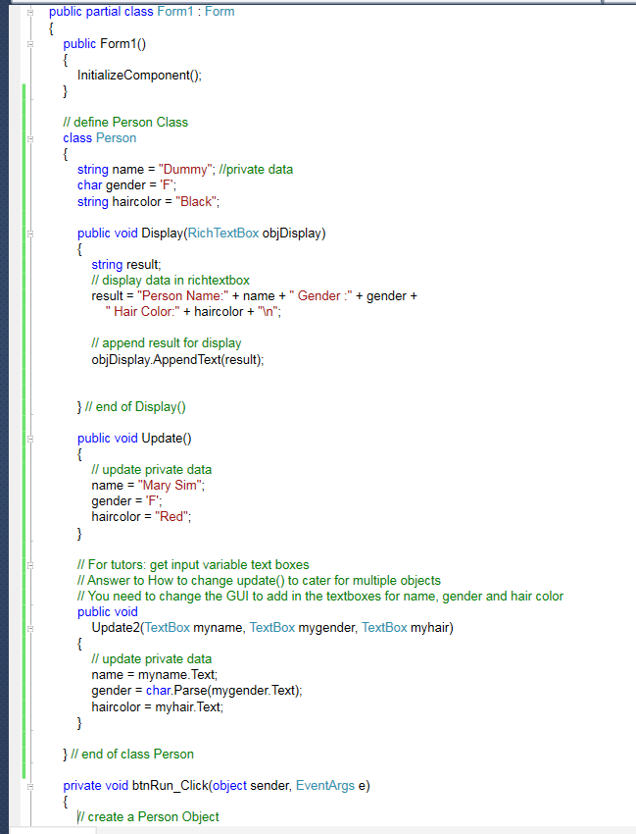
Sequence of Codes
Class definition is in class FORM1
Class definition is ABOVE the button_click method

Slide 17
Observe the output
Run the application
Observe the output
Fill in the blanks:
Class name:
Object name:
Class member data:
Class member method:
How to create object?
How to call object member method?
How to access to object member data?

Slide 18
C# example on class and object
Can we create multiple objects of the same class? YES
How?
For example, we would like to create 2 objects. Name as Tom and John of Person class.
Object
Person
Tom
Object
John

Slide 19
C# code: To Create 2 Person objects
No change in the Person class
But modify the btnRun_Click()
Run the application and observe the output
private void btnRun_Click(object sender, EventArgs e)
{
// create 2 Person Objects
Person Tom = new Person();
Person John = new Person();
// call update and display ()
Tom.Update(); Tom.Display(rtbDisplay);
// call update and display ()
John. Update();
John. Display(rtbDisplay);
} // end of btnRun_Click
Object
Tom
Object
John

Slide 20
C# code: To Create 2 Person objects
To test your understand:
  See! What is being displayed at the rich text box?
  Think! Explain the result.
  We have created 2 objects but why are they displaying the SAME result?
  How to solve the problem?
  Hints:
    You need to change the GUI and create update2() method to read input from textboxes
Object
public void Update2(TextBox myname, TextBox mygender, TextBox myhair)
{
// update private data
name = myname.Text;
gender = char.Parse(mygender.Text);
haircolor = myhair.Text;
}
Tom
Object
John

Slide 21
How to get started ?
1st Step - identify the OBJECT that is required.
Example:
You wish to computerize a book rental store. The main activities are purchase books, rent books out, and accept return books.
What Object are we interested in?
Next identify all the Data Members (descriptors) and Method members (actions or behavior)
Data Members:
Method Members:
2nd Step – Create the CLASS definition for the Object. This is a template that is used to create the Real Object(s).
3rd Step – Use the Class definition to create the Real Object(s).

Slide 22
Practical 4A- Part 1:
Classes with Data members
You need to store the title, artist and price of some DVDs.
  Decide what type of object is required.
  Decide what data each object will store.
  Complete the class definition
  Class _____________
  {
  string title;
  string artist;
  float price;
  }

Slide 23
Practical 4A- Part 1:
Classes with Data members
You need to store the name, age and height of some people.
  Decide what type of object is required.
  Decide what data each object will store.
  Complete the class definition
  class Person
  {
  }

Slide 24
Practical 4A- Part 1:
Classes with Data members
You need to store the name, IC, and bank balance of customers.
  Decide what type of object is required.
  Decide what data each object will store.
  Complete the class definition
  class Customer
  {
  }

Slide 25
Method Members in a Class
The definition of an object (i.e. the class) can contain member methods.
Member methods represent the behaviour of the object or the messages that can be passed to the object.
Class methods are usually PUBLIC type. This allows anyone to use them.
Class data are usually PRIVATE type. They are only accessible within CLASS
We provide PUBLIC getter method to return the content of the private data e.g
  public int GetAge()
We provide PUBLIC setter method to set private data e.g
  public void SetAge(int x)

Slide 26
Differential Learning:
Method Members in a Class
Way to access private data via Method members in class we need:
Getter and Setter methods .
It accesses the private data
(without using any window form elements)
OR
2. Update by reading user control (e.g textbox)
class Person
{
private int age;
public void SetAge( int x )
{
age = x; // modify the private data
}
public int GetAge( )
{
return age; // return private data
}
}
age is private data.
It can only be accessed in Person class
age value can be set to value x in the PUBLIC Setter method
age value can be return via PUBLIC Getter method

Slide 27
Differential Learning:
Method Members in a Class
Class Methods (e.g Update() ) can access PRIVATE data members in the same class.
Example:
class Student
{
int age; // private data
//myage is the controls use to age of student
public void Update (textBox myage )
{
age = int.Parse(myage.Text);
}
} // end of class student
age is private data. They can only be read in Student class

Slide 28
Creating Objects from a Class
Try the program below and understand how to create object and access its members and method.
class Person
{
public string name;
public float height;
private int age; // private data
public int GetAge() // getter method
{
return age; // return private data
}
public void SetAge(int a) // setter method
{
age = a; // set private data
}
// myage is the controls use to update age of student
// this is NOT the same method as setter. It accesses the window form element textBox
public void Update (textBox myage ) //public method
{
age = int.Parse(myage.Text); // age is private
}
} // end class Person
// continue in next silde on how to access the object
MUST Try!! It is important ***

Slide 29
class Program
{
private void btnRun_Click(object sender, EventArgs e)
{
Person A = new Person();
Person B = new Person();
// update public data directly
A.name = “Ah Beng”;
A.height = 1.72f;
B.name = “Ah Hua”;
B.height = 1.65f;
// display public data
rtbDisplay.Append ( "Person A:\n");
rtbDisplay.Append ( "Name is" + A.name + “\n” );
rtbDisplay.Append ( "Height is " + A.height + “\n” );
rtbDisplay.Append ( "Person B\n");
rtbDisplay.Append ( "Name is" + B.name + “\n” );
rtbDisplay.Append ( "Height is " + B.height + “\n” );
// access private age
A.SetAge(18);
B.SetAge(20)
// display private age
rtbDisplay.Append ( "Person A’s age is” + A.GetAge().ToString() +“\n");
rtbDisplay.Append ( "Person B’s age is” + B.GetAge().ToString() +“\n");
}
} // end class Program
Use dot “.” to access Public data
Call getter and setter methods to access Private data

Slide 30
Practical 4A- Part 2:
Classes with Method members
You need to store the title, artist and price of some DVDs. You are able to Update and Display the data.
Provide getter methods to get price of DVD such as GetPrice(). We will be using GetPrice() to compute the total price.
Complete the class definition with data members (ALL Private) and method members (ALL Public). Create an application.
    When user clicks on Run button: it creates 2 DVD object
    When user clicks on respective Update and Display buttons to update and display the data
    When user clicks on Total button, it computes the total price of the 2 DVD
Part of the codes are provide. Fill in the blanks.

Slide 31
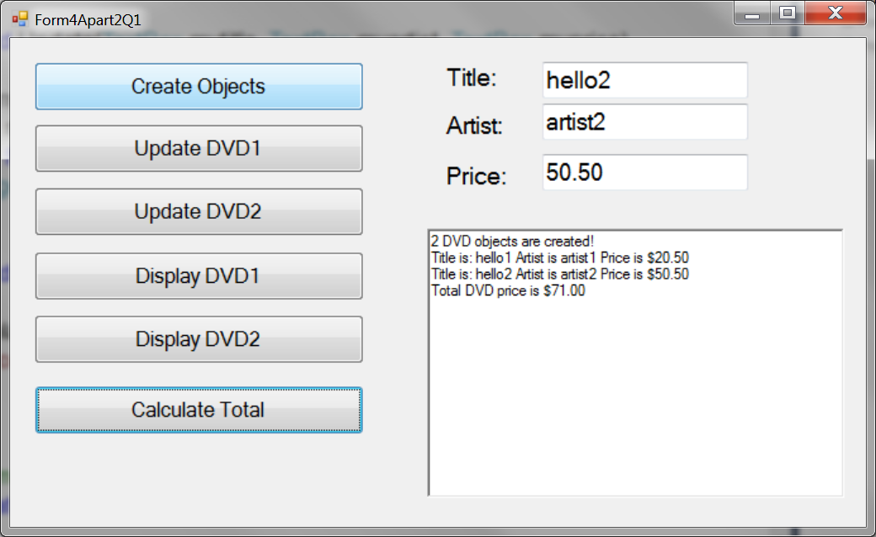
Practical 4A- Part 2:
Classes with Method members
Here is the GUI and samples of output
txtTitle
txtArtist
txtPrice
rtbDisplay

Slide 32
Practical 4A- Part 2:
Classes with Method members
      Fill in the missing codes
namespace classAndobject
{
public partial class Form4Apart2Q1 : Form
{
public Form4Apart2Q1()
{
InitializeComponent();
}
// class variable for two objects
DVD d1, d2 ;
// Run button will create 2 objects
private void btnRun_Click(object sender, EventArgs e)
{
// create 2 DVD objects
d1 = new DVD();
d2 = ____________________________ ;
rtbDisplay.AppendText("2 DVD objects are created! \n");
}

Slide 33
Practical 4A- Part 2:
Classes with Method members
class DVD
{
string title="default title";
string artist = "default artist";
float price = 0f;
public void Update(TextBox mytitle, TextBox myartist, TextBox myprice)
{
title = mytitle.Text;
__________ = myartist.Text;
__________ = float.Parse( ________________ );
MessageBox.Show("DVD updated!");
}
public void Display(RichTextBox mydisplay)
{
mydisplay.AppendText("Title is: " + title + " Artist is " + ______________ + " Price is " + ___________.ToString("C") + "\n");
}
// Getter method for GetPrice
public _____________ GetPrice()
{
return __________________ ;
}
} // end of Class

Slide 34
Practical 4A- Part 2:
Classes with Method members
private void btnUpdateDVD1_Click(object sender, EventArgs e)
{
d1.Update(txtTitle, txtArtist, txtPrice);
}
private void btnUpdateDVD2_Click(object sender, EventArgs e)
{
___________.Update(______, ______, ________) ;
}
private void btnDisplayDVD1_Click(object sender, EventArgs e)
{
d1.Display(rtbDisplay);
}
private void btnDisplayDVD2_Click(object sender, EventArgs e)
{
___________.Display(___________);
}
private void btnTotal_Click(object sender, EventArgs e)
{
____________ total;
total = d1.GetPrice() + ______.____________;
rtbDisplay.AppendText("Total DVD price is " + total.ToString("C") + "\n");
}
} // end of partial class
} // end of namespace

Slide 35
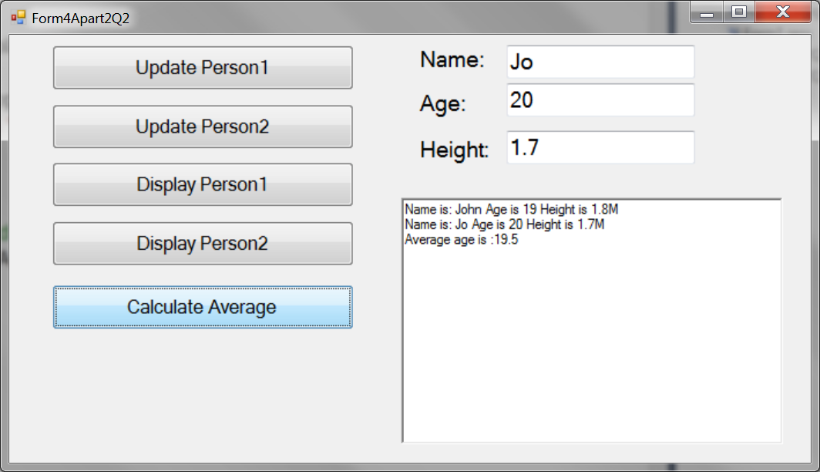
Practical 4A- Part 2:
Classes with Method members
You need to store the name, age and height of some People and to Update and Display the data. Provide methods to set and get age private data. Complete the class definition with data members (ALL Private) and method members (ALL Public).
Create an application.
    When loads form, it creates 2 person objects
    When user clicks on respective Update and Display buttons to update and display the data
    When user clicks on Average button, it computes the average age of the 2 persons
txtName
txtAge
txtHeight
rtbDisplay

Slide 36
Practical 4A- Part 2:
Classes with Method members
Hints:
Create 2 class variables for person
In Load form event, create the 2 person objects
// Class variables
Person P1, P2;
private void Form4Apart2Q2_Load(object sender, EventArgs e)
{
// create objects when load form
P1 = new Person();
P2 = new Person();
}
Double click on the form, IDE will create the _Load Method for you!
The P1 and P2 objects will be created when the Form is first loaded.

Slide 37
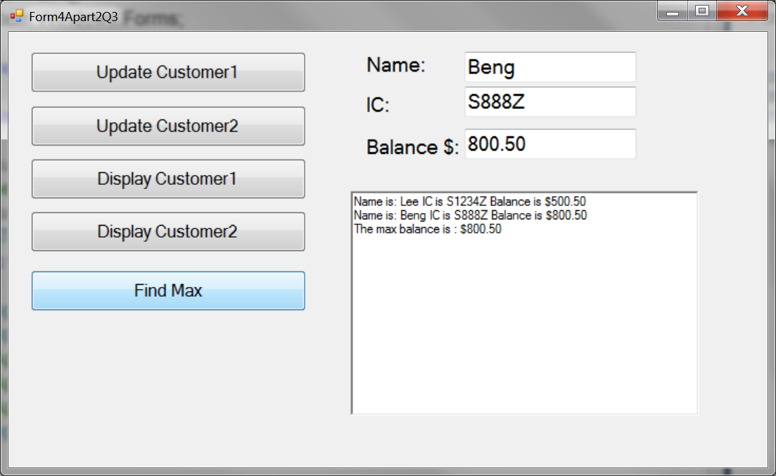
Practical 4A- Part 2:
Classes with Method members
You need to store the name, IC, and bank balance of customers and to Update and Display the data.
Provide setter and getter methods for bank balance (the private data).
Create an application.
    When loads form, it creates 2 customers objects
    When user clicks on respective Update and Display buttons to update and display the data
    When user clicks on FindMax button, it find the max balance and display it.
    [Bonus!] Add a Clear button to clear the data of both customer objects. You need to call the setter methods to clear the date
Clear

Slide 38
Project
Try to apply class and objects in your IT1762 project.
Self Learn: Advance Objects
Array of Objects
It combines the concepts of Array, For loop, Class and Object
http://www.dotnetperls.com/object-array
You need it to implement bonus features for your project. ☺

Slide 39
Creating Objects from a Class
Once a class has been defined, you can create many objects from this class, like declaring variables:
eg.
class Person{ … }
Person limin = new Person();
Person thomas = new Person();
Syntax:
class_name variable_name = new class_name( );
How to Use an Object
The dot ‘.’ is used to refer to one of the members of the object.
eg. limin.height = 1.65;
thomas.height = 1.75;
Note: you can use the dot ‘.’ only if the data member or method is PUBLIC

Slide 40
Summary
How to define a class
class <class_Name>
{
<class body>
}
Define Data members of a class
  Private type
  Public type
Define Method members of a class
  Usually Public type
Define Getter and Setting Methods members of a class
  Public type
  Return private data
  Set private data
How to create Objects from a class.

Slide 41
IT1762
Data Structures & Algorithms
End of Topic 4
Class and Objects in C#

